Slide 1
HANDWRITTEN MATHEMATICAL EQUATION RECOGNISER AND SOLVER USING CNN
DEPARTMENT OF CSE
Under the guidance of
Mrs. Dr. N SARANYA
Associate Professor
PROJECT ASSOCIATES
Roll Number | Name
19711A0566 | N. Ramya
19711A0572 | P. Akshitha Reddy
19711A0597 | Sk. Washma Zayb
19711A05B0 | T. Yamini
18711A05A5 | U. Sharone

Slide 2
CONTENTS
ABSTRACT
EXISTING SYSTEM
LIMITATIONS
PROPOSED SYSTEM
ADVANTAGES
LITERATURE SURVEY
PROBLEM SPECIFICATION
SYSTEM ARCHITECTURE
DESIGN
ALGORITHMS AND TECHNIQUES
METHODOLOGY
SYSTEM REQUIRMENTS
EXPECTED OUTCOME
TEST CASES
REFERENCES

Slide 3
ABSTRACT
Mathematical Equations are frequently entered by hand on computer which is slower than writing them on paper or writing software. Through this project we aim to develop a user friendly website that captures the image of mathematical equation, recognize the equation and present the user with required solution. We aim to make the whole experience of experimenting with equations very user friendly and to remove the hassle of learning a mathematical tool just for mathematical experimentation. Since mathematics itself is a very wide field, digitizing and evaluating all of the mathematical symbols becomes a very complex and tedious task. Therefore, only a subset of these mathematical symbols is considered in this project which are digits (0-9), arithmetic operators (+, -, *, ÷), characters(y). This Project will be entirely dedicated to the digitization and evaluation of handwritten mathematical expressions.

Slide 4
LITERATURE SURVEY
Stroke Extraction for Offline Handwritten Mathematical Expression Recognition
A stroke extraction algorithm is required to convert a bitmap image to a sequence of strokes.
The set of strokes is reconstructed by finding a set of paths on a graph based representation of skeleton, in which vertexes and edges represent junctions and segments respectively.

Slide 5
LITERATURE SURVEY
Methods for Lines and Matrices Segmentation in RNN-based Online Handwriting Mathematical Expression Recognition Systems
Shallow Neural Networks(RNN) uses single Hidden layer, hence it requires separate feature extraction Process.
Shallow Neural Networks takes small amount of data which reduces the accuracy.

Slide 6
EXISTING SYSTEM
Training an Stroke Extraction for Handwritten Mathematical Expression Recognition system based is a challenging task.
Handwriting recognition has already achieved results using shallow networks like recurrent neural networks RNN in recognizing unconstrained handwriting

Slide 7
LIMITATIONS
There is no available public dataset of online handwritten MEs.
Ambiguity of handwriting production, which can be considered as overlapping between classes.
Existing System is time Consuming.
Existing system is either offline or offline.
Feature extraction-Individual properties of symbols were hard-coded, and matched to input symbols.

Slide 8
PROPOSED SYSTEM
Our approach to the problem can be broken down into three broad steps.
1. Preprocessing and segmenting the image to extract the expression variables, operators and operands
2. Recognizing the handwritten equation using CNN and by doing so, digitizing it
3. Solving the equation and presenting the user with the output
Only arithmetic equations and linear mathematical expressions were considered.

Slide 9
ADVANTAGES
An interactive Website to upload an image (offline).
Also provide interface to write the Equation on the screen(online).
Correct evaluation can be achieved by applying BODMAS.
Less Time is Taken to predict the equation.

Slide 10
PROBLEM SPECIFICATION
Reduce the hassle of entering Mathematical Equations by hand on computer which is slower than writing them on paper or writing software.
Enables both online and offline expression recognition and solving.

Slide 11
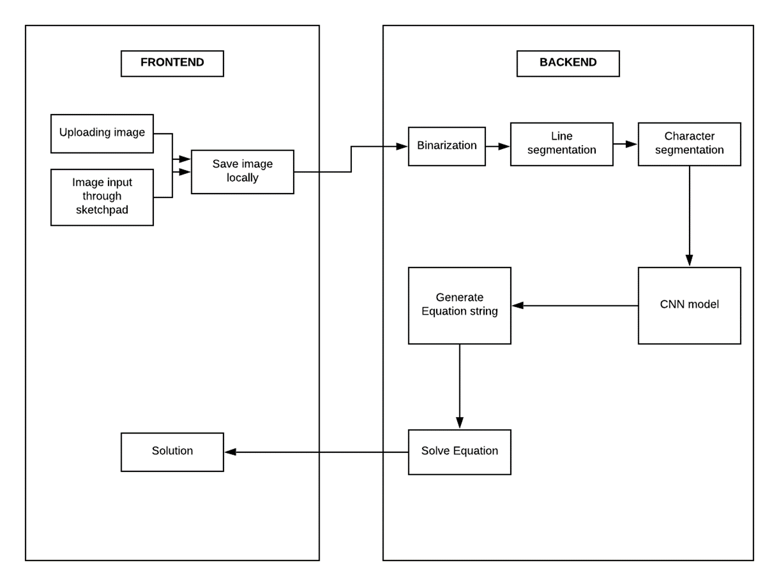
SYSTEM ARCHITECTURE

Slide 12
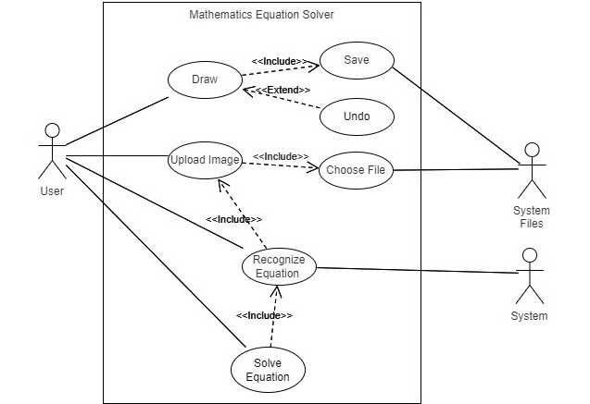
DESIGNS
1. Use Case Diagram

Slide 13
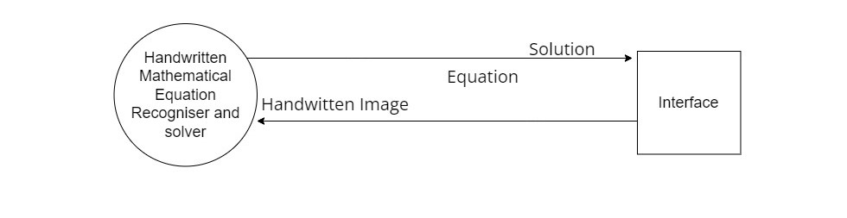
DESIGNS
2. Data Flow Diagram

Slide 14
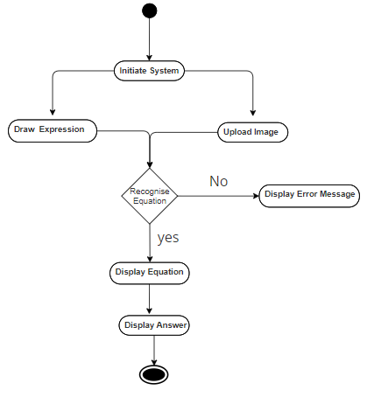
DESIGNS
3. Activity Diagram

Slide 15
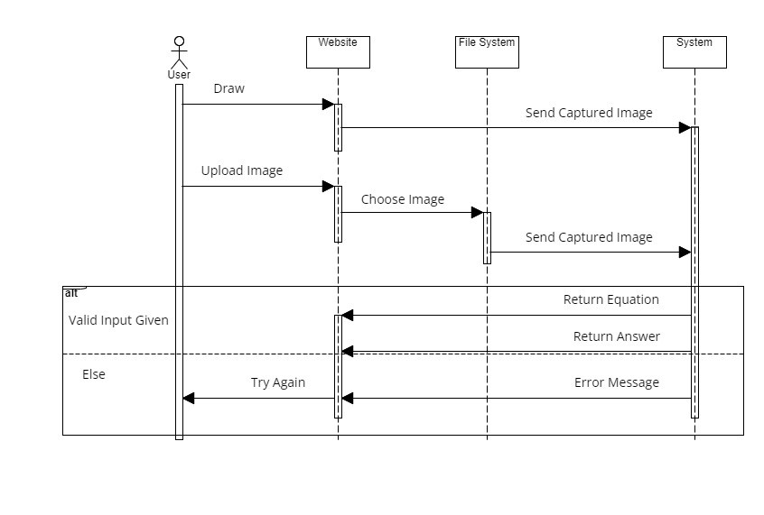
DESIGNS
4. Sequence Diagram

Slide 16
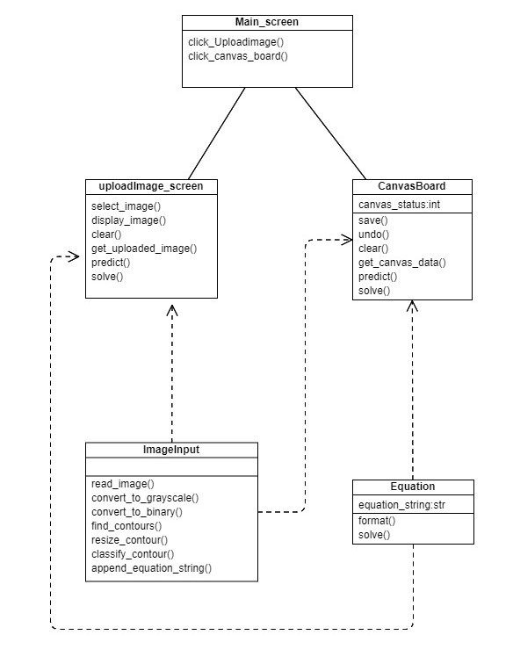
DESIGNS
5. Sequence Diagram

Slide 17
ALGORITHM &TECHNICQUES
CONVOLUTIONAL NEURAL NETWORKS :
The recognition of the segmented symbols from images is done using Convolutional Neural Network (CNN) because of their state-of-the-art performance in classification of images.
This will result in a completely digitized mathematical expression present in the image.
The expression obtained after the classification is a stream of characters stored in a string and is evaluated to give the Result.
Max Pooling
Fully Connected Layer and Output
Output Layer

Slide 18
METHODOLOGY
1. Data Collection
https://www.kaggle.com/datasets/xainano/handwrittenmathsymbols?select=data.rar
The dataset was used from Kaggle and it consisted images of handwritten digits.
digits (0-9)
arithmetic operators (+, -, *, ÷)
Characters (y)
Trained 45055 images belonging to 16 classes.

Slide 19
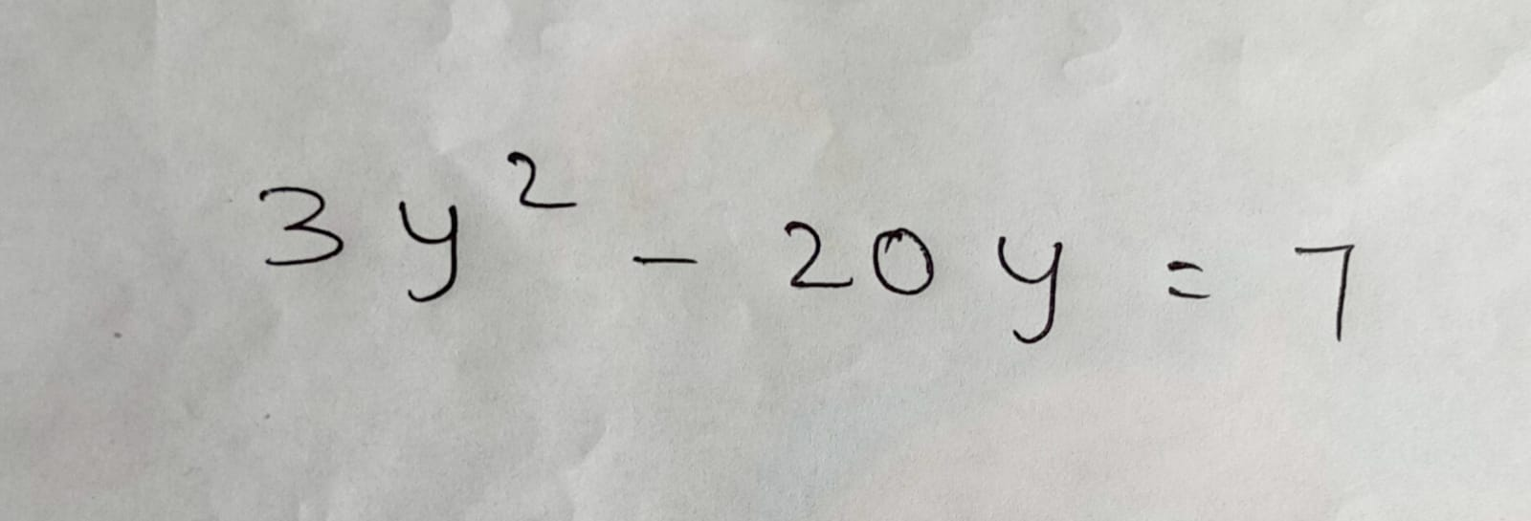
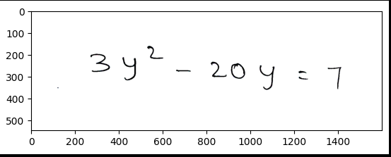
METHODOLOGY
2.Pre-processing Input Image
Binarization is the method of converting any grayscale image, RGB Image into a black-white image. In a simple example, transforming an image's gray-scale from the 0-255 spectrum to a 0-1 spectrum is binarization.

Slide 20
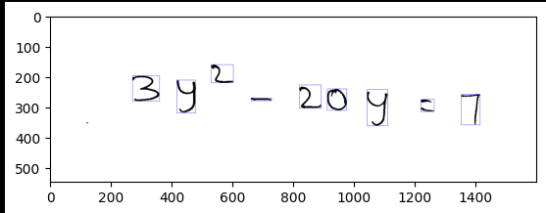
METHODOLOGY
2. Segmenting Pre-processed Images
Bounding Box
In digital image processing, the bounding box is merely the coordinates of the rectangular border that fully encloses a digital image

Slide 21
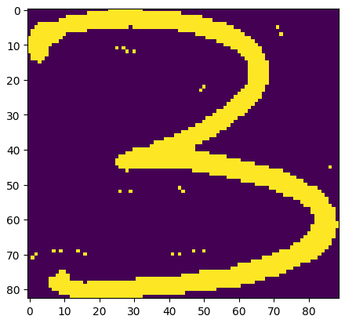
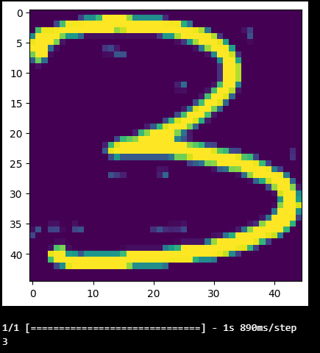
METHODOLOGY
2.Countour Based Segmentation
Each image was resized 45x45, to match the size of images of the training dataset. Contours are defined as the line connecting all the points along an image's borders that have the same intensity.

Slide 22
METHODOLOGY
3.Building Model
The model is built using Keras.
The model created is a Sequential model.
First, a set of two Convolutional layers (32 filters and ReLU activation function) to identify the low level image patterns (lines, edges, etc.).
Total there are 1 input layer and output layers,6 hidden layers and 2 dense layers.
the model is trained on the dataset with 3 epoches and a batch size of 32.

Slide 23
METHODOLOGY
4. Expression Evaluation
The segmented characters need to be recognized in order to be digitized.
These characters will be sorted and stored in the same order as they appear in the image of the expression.
The Expression is formatted properly and evaluated using Sympy Library.

Slide 24
SYSTEM IMPLEMENTATION
5. Deployment
Deployed the trained model and the solver as an application that can take input images of handwritten equations, recognize them, parse them, and solve them.
This is done using a web-based interface created using Flask module in python.

Slide 25
SYSTEM REQUIRMENTS
Software Requirements :
Operating System : Windows 10
Front end :HTML,CSS,JAVASCRIPT
Back end: Flask
Important Libraries: Tensorflow, sympy, OpenCv,PiL
Language : Python
Tools : Visual Studio Code
Hardware Requirements :
Processor : i3 or more
RAM : 4GB or more

Slide 26
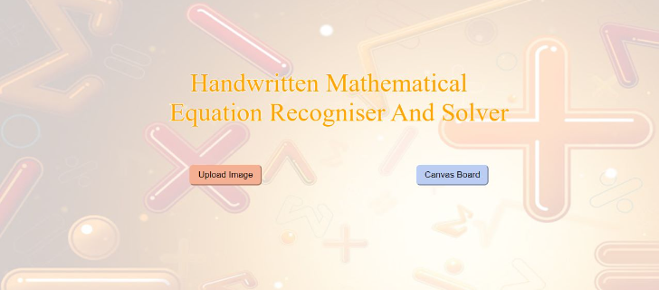
RESULT AND OUTPUT

Slide 27
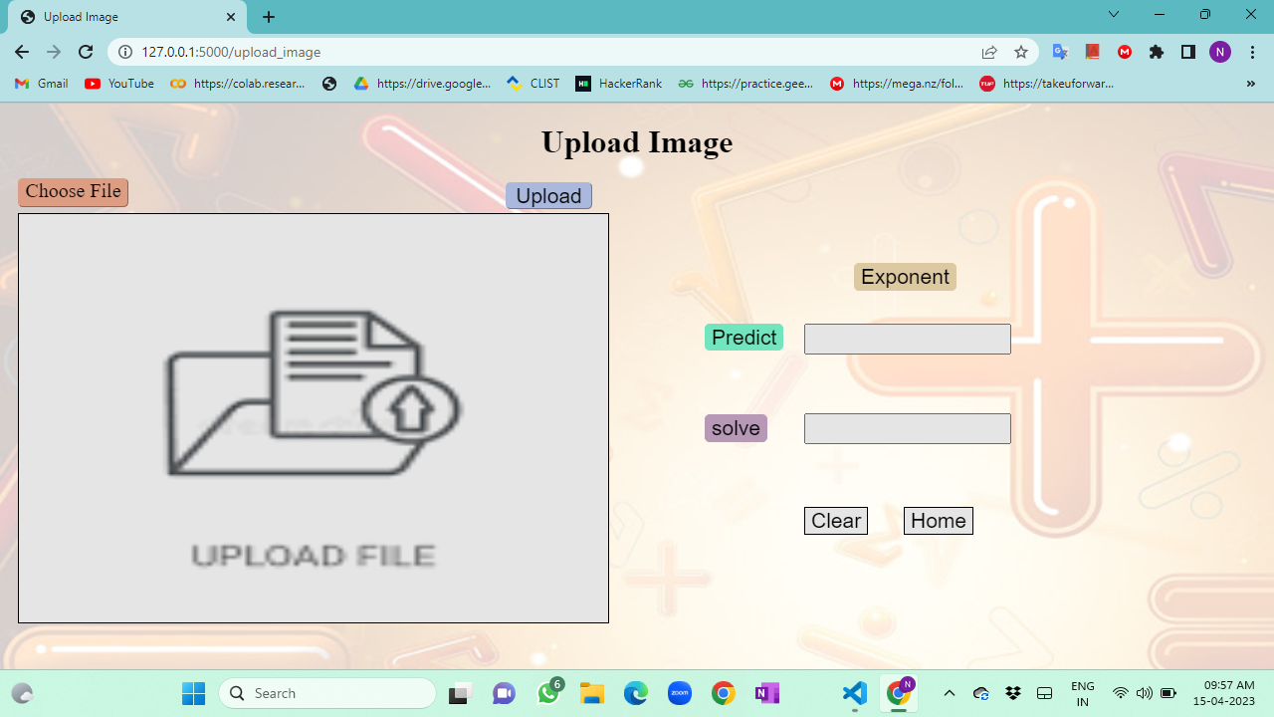
RESULT AND OUTPUT

Slide 28
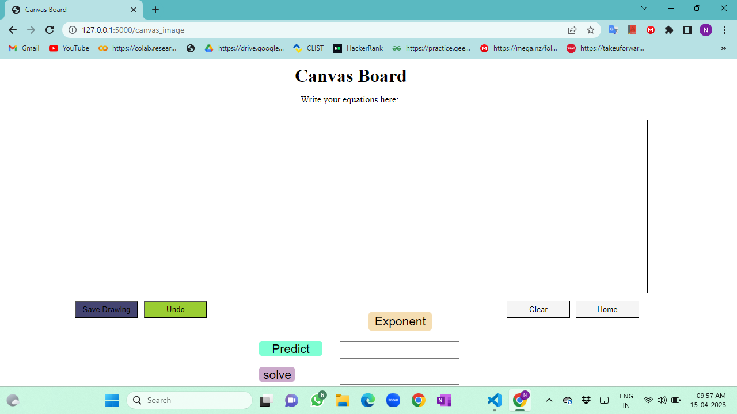
RESULT AND OUTPUT

Slide 29
UNIT TESTING
Test Case Id | Test scenario | Input | Expected Output | Actual output | Result
UT001 | Basic recognition | Image of a simple addition equation | Equation Recognised And Solved | Equation Recognized And Solved | pass
UT002 | polynomial Equation recognition With variable. | Image of a polynomial equation With One Variable ‘y’ | Equation Recognised And Solved | Equation Recognised And Solved | Pass
UT003 | Exponent Recognition | Exponent value less than 10 | Equation Recognised And Solved | Equation Recognised And Solved | Pass

Slide 30
UNIT TESTING
UT007 | Error handling | Input an equation that is not valid (e.g., "2 + =") | Equation Recognised And display Error Message “Wrong Equation” | “Wrong Equation “ | Pass
UT008 | Empty Image Recognition | Empty Image | Display “Empty Image” | Display “Empty Image” | Pass
UT009 | Distorted Image Recognition | Image with lot of Noise | Equation Recognised And Solved | Equation not Recognised Properly | Fail
UT010 | Multiple Equations Recognition | Batch of multiple equations | Equation Recognised And Solved | Equation not Recognised Properly | Fail

Slide 31
TEST CASES INTEGRATION TESTING
Test Case Id | Test scenario | Input | Expected Output | Actual output | Result
IT001 | Data Flow | Upload without choosing File | Error message: “No image Selected" | “No image Selected” | pass
IT002 | Data Flow | Empty Canvas | Error message: “Draw Equation on canvas." | “Draw Equation on canvas." | Pass
IT006 | Solving | Without Predicting Equation | Error Message “Predict something” | “Predict something” | Pass

Slide 32
REFERENCES
[1] Recognition of Handwritten Mathematical Expression and Using Machine Learning Approach Prathamesh Tope1, Sarvesh Ransubhe2, Mohammad Abdul Mughni3, Chinmay Shiralkar4, Mrs. Bhakti Ratnaparkhi.
[2] Handwritten mathematical equation solver Rajwardhan Shinde, Onkar Dherange, Rahul Gavhane, Hemant Koul, Nilam Pati
[3] Salma Shofia Rosyda and Tito Waluyo Purboyo ,“A Review of Various Handwriting Recognition Methods”, International Journal of Applied Engineering Research ISSN 0973- 4562 Volume 13, Number 2 (2018) pp. 1155- 1164
[4]https://www.kaggle.com/datasets/xainano/handwrittenmathsymbols?resource=download
[5]https://vipul-gupta73921.medium.com/handwritten-equation-solver-using-convolutionalneural-network-a44acc0bd9f8

Slide 33
THANK YOU

